Slide 1
Newly Elected County Officials Training Workshop
Department for Local Government
Office of Financial Management & Administration
Counties Branch
December 7, 2022
Notes:
ROBERT BROWN –Intro/Welcome & DLG Organization

Slide 2
Topics
“Your” Department for Local Government
Those who serve the county
Newly Elected Officials Checklist
Ordinances, Orders & Resolutions
Handling of Public Funds
Salaries
DLG Website
County Officials Training Program

Slide 3
What is DLG?
Department for Local Government
Created to assist all local governments throughout Kentucky
Grant and loan assistance
Technical assistance and financial management oversight

Slide 4
How DLG is Structured
Commissioner’s Office
Commissioner: Dennis Keene
Chief of Staff: Eddie Jacobs
Office of Financial Management & Administration
Wil Rhodes
Office of Federal Grants
Billie R. Johnson

Slide 5
How DLG is Structured
Office of State Grants
Billie R. Johnson, Executive Director
Office of Legal Services
Matt Stephens, Chief Counsel
Office of Field Services
Eddie Jacobs, Director
Kentucky Infrastructure Authority
Sandy Williams, Executive Director
Notes:
Please separate like previous slide. Keep all info on 1 slide. Field Services executive director is Aaron Thompson.

Slide 6
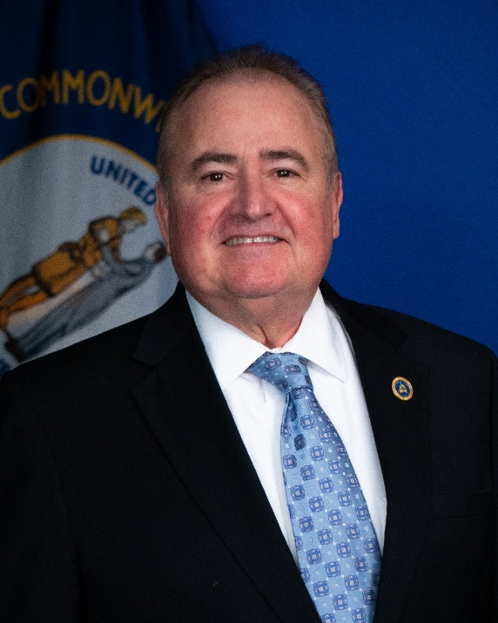
Meet the Commissioner
Dennis Keene
Department Commissioner
Also serves as the
State Local Debt Officer
Notes:
Switch slides 4 and 5

Slide 7
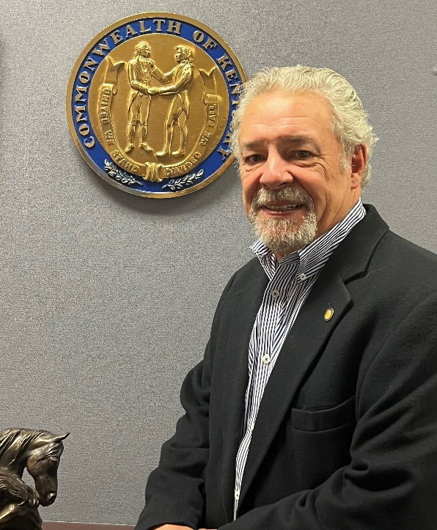
Office of Financial Management & Administration (FM & A)
Eddie Jacobs
Chief of Staff
Notes:
Switch slides 4 and 5

Slide 8
Financial Management & Administration (FM&A)
Establish and administer local government uniform accounting system and reporting requirements. (KRS 46.010, KRS 68.210, KRS 68.220)
Approve County Budgets and their amendments. (KRS 68.270, KRS 68. 280)
Investigate County financial conditions. (KRS 68.350)
Provide technical assistance and information to local governments. (KRS 147A.020)
Conduct training programs for local officials.
(KRS 147A.020)
Notes:
- Establish/administer local government uniform accounting system and reporting requirements
(KRS 46.010, KRS 68.210, KRS 68.220, others)
- Approve County Budgets and their amendments (KRS 68.270, KRS 68.280)
Investigate County financial condition (KRS 68.350)
Provide technical assistance and information to local governments (KRS 147A.020)
Conduct training programs to local officials (147A.020)

Slide 9
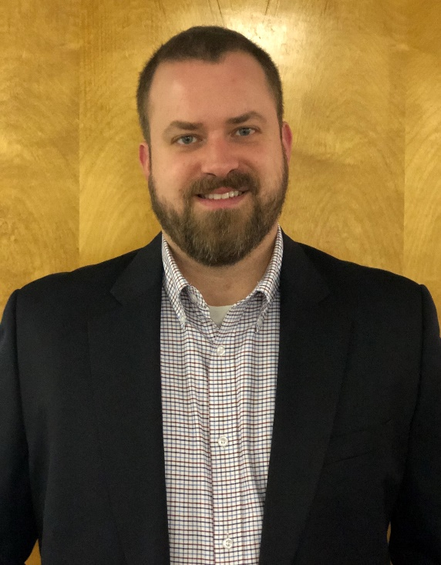
Counties Branch
Wil Rhodes
Office of Financial Management Executive Director
Phone: 502-892-3471
Email: Wil.Rhodes@ky.gov
Notes:
Switch slides 4 and 5

Slide 10
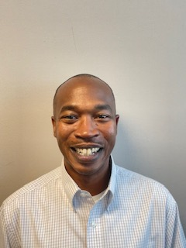
Counties Branch
Robert Brown
State Local Finance Officer, Branch Mgr. and Local Government Advisor
Serves as advisor to the counites of the following Area Development Districts
Northern Kentucky
Phone: 502-892-3433
Email: Roberto.Brown@ky.gov
Notes:
Switch slides 4 and 5

Slide 11
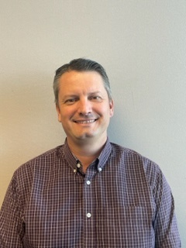
Counties Branch
Jaarad Taylor
Local Government Advisor
Serves as advisor to the counites of the following Area Development Districts
Phone: 502-892-3512
Email: Jaarad.Taylor@ky.gov
Bluegrass | Big Sandy
Buffalo Trace | FIVCO
Gateway
Notes:
Switch slides 4 and 5

Slide 12
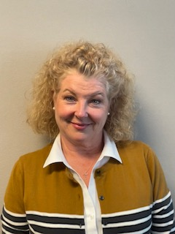
Counties Branch
Lisa Dale
Local Government Advisor and Coordinator for Local Debt Reporting
Serves as advisor to the counites of the following Area Development Districts
Phone: 502-564-9991
Email: Lisa.Dale@ky.gov
Barren River | Cumberland Valley
Kentucky River | Lake Cumberland
Notes:
Switch slides 4 and 5

Slide 13
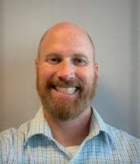
Counties Branch
William Summersett
Local Government Advisor
Serves as advisor to the counites of the following Area Development Districts
Phone: 502-892-5843
Email: Williamn.Summersett@ky.gov
Green River | Lincoln Trail
KIPDA | Pennyrile
Purchase
Notes:
Switch slides 4 and 5

Slide 14
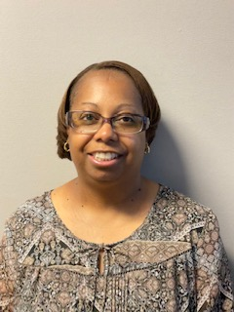
Counties Branch
CaSandra Stallard
Serves as Administrative Support to Counties Branch
Phone: 502-892-3477
Email: CaSandra.Stallard@ky.gov
Notes:
Switch slides 4 and 5

Slide 15
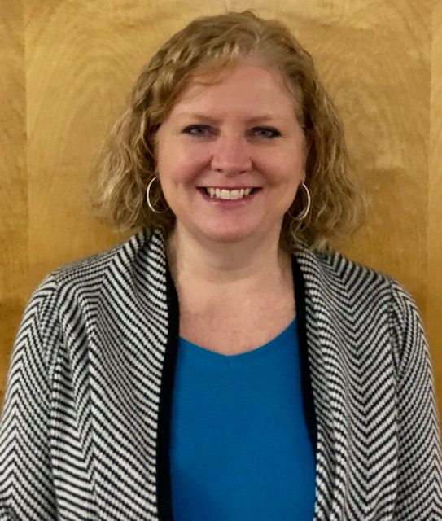
Counties Branch
Wendy Thompson
Local Government Advisor
Coordinator of the County Officials Training Program
Phone: 502-892-3479
Email: Wendy.Thompson@ky.gov
Notes:
Switch slides 4 and 5

Slide 16
Those Who Serve The County Robert Brown
Notes:
Add County to Employees

Slide 17
Those Who Serve The County
Elected Officials
Appointed Officials
Deputies and Assistants
All other County Employees
Notes:
Add County to Employees

Slide 18
Those Elected to Serve The County
County Judge Executive
Justices of the Peace (Magistrates) & Commissioners
County Sheriff
County Clerk
Coroner
Jailer
Property Valuation Administrator
County Attorney
Constable
Notes:
Make Elected Officials bigger and everything else a tad smaller

Slide 19
Elected Officials
Serve a defined term
Receive monthly compensation regardless if they show up for work
Do not receive sick/vacation days, compensatory time or overtime
Notes:
Space after “show up for work

Slide 20
Elected Officials
Are subject to indictment or prosecution for misfeasance, malfeasance or willful neglect of duty during their term of office
In the absence of good cause shown, a member of fiscal court who fails to attend 50% of the regular meetings within a six month period or who fails to attend 2 consecutive meetings shall be charged with neglect of office and upon conviction shall forfeit their office.

Slide 21
Appointed Officials
Serve a set term
Are appointed with fiscal court approval
Salaries are set by the fiscal court
All county appointed offices are listed in “County Government in Kentucky” see LRC Informational Bulletin #115

Slide 22
Appointed Officials
County Treasurer
Appointed every four years at regular June meeting of fiscal court
Can be nominated by any member of the fiscal court
Road Supervisor
Terms can be two or four years, takes office the second Tuesday in January of an odd-numbered year
Must be nominated by the County Judge Executive
Must have three years of experience and pass an exam (exam administered by Transportation Cabinet)

Slide 23
Appointed Officials
Dog Warden
Per KRS 258.195, each county must have a dog warden and a dog pound. Small counties may establish a regional facility with nearby counties
Disaster Emergency Management Director
Represents the Judge Executive on all matters pertaining to the Counties emergency management program and the disaster and emergency response of the county

Slide 24
Deputies and Assistants
Offices which have deputies and assistants:
Judge Executives
Jailer
Coroner
Clerk
Sheriff
The number of deputies and assistants is set by the fiscal court
Except deputies and assistants of fee officers (Clerk and Sheriff)
Serve at the pleasure of the official
Notes:
Space after “Offices which have deputies and assistanst”. Bullet list the Judge Executives, Jailer, Coroner etc. Space after “assistants is set by the fiscal court”

Slide 25
Deputies and Assistants
Do not require fiscal court approval
Individual Salaries are set by fiscal court
Except deputies and assistants of the clerk and sheriff
Are subject to state and federal wage and hour laws

Slide 26
County Employees
Can only be removed with the approval of the fiscal court pursuant to the policies adopted by the county in the Administrative Code
Are subject to state and federal wage and hour laws

Slide 27
Other Personnel Issues
Retirement System
Social Security
Health Insurance
All are outlined in “County Government in Kentucky” see LRC Informational Bulletin #115

Slide 28
Newly Elected Checklist

Slide 29
Materials
Checklist
Oaths
Sample Orders
County Assignments
County Budget Workshop Schedule
Certification of Prior Years of Service
Training Guidelines

Slide 30
Checklist -- Newly Elected County Officials
On or before January 2, 2023:
Execute bond -- before taking office!
Only County Attorneys and Magistrates/Commissioners are exempt from the bonding requirement
Notes:
Change date to January 5, 2015

Slide 31
KRS 67.720
The county judge shall execute a bond for the faithful performance of the duties of his office.
The bond shall be a minimum of ten thousand dollars ($10,000) with sureties approved by fiscal court, which shall record the approval of the sureties in its minutes.
Notes:
Take bullet out

Slide 32
KRS 67.720 continued…
If the fiscal court does not approve sureties under this section within thirty (30) days after the county judge/exec. has taken office, the Circuit Judge shall approve the sureties.
Premiums on the bond of the county judge/executive shall be paid from county funds appropriated by the fiscal court. The fiscal court shall file a record of the bond with the county clerk.
Notes:
Take out bullet

Slide 33
KRS 62.990
(1) …shall be fined not less than five hundred ($500) nor more than one thousand dollars ($1,000).
(2) …office shall be considered vacant and he shall not be eligible for the same office for two (2) years.
(3) Any officer removed under this statute may seek relief from the fiscal court to remove the disqualification from holding the same office

Slide 34
On or before January 2, 2023:
Take oath(s) of office -- before assuming duties
Meet with county treasurer regarding county budget
Obtain and review most recent inventory listing of county property

Slide 35
On or before January 2, 2023:
Review personnel situation and carefully contemplate planned action.
Obtain copy of order pursuant to KRS 64.530 regarding office staff
Make arrangements/advertise for special fiscal court meeting as soon as possible for purpose of appointing county employees, and approving sureties
Notes:
Change date to January 5, 2015

Slide 36
On January 2, 2023
Have deputies sworn in
Arrange for new signature cards at bank(s) if needed
Redo security agreements if needed
Redo authorized signature forms where applicable, for grants

Slide 37
At The First Fiscal Court Meeting:
If not already approved, fiscal court votes to approve sureties for bonds of officials as required -- see handout
Appoint deputies, employees, office staff -- see handout
With fiscal court approval, judge/exec. appoints county employees -- see handout

Slide 38
At The First Fiscal Court Meeting:
Review budgets and financial statements for fee offices
Approve fee office budgets (by January 15) as a whole or by line item
Fiscal court authorizes jailer to accept bond release fees (if desired)--KRS 431.5305
Road supervisor must be appointed by January 10, 2023 for a 2 or 4 year term.-- KRS 179.020
Notes:
Change date at bottom to January 13, 2015

Slide 39
As soon as possible, review copies of and become familiar with:
Budget and amendment ordinances, transfer orders
Most recent quarterly report, including liabilities section
Treasurer’s monthly report to fiscal court
Notes:
Change date to 6/30/2014. Take out “we have an electronic copy……..)

Slide 40
As soon as possible, review copies of and become familiar with:
County Administrative Code (KRS 68.005)
General Administration
Personnel policies
Purchasing policies
Administration of county fiscal affairs
Delivery of county services
Notes:
Fit County Administrative Code, etc. all on 1 line

Slide 41
As soon as possible, review copies of and become familiar with:
Purchasing policies
Bid requirements, statutory and local (state price contracts)
Open meetings law and policy
Open records law and local policies
Fiscal court procedures and meetings

Slide 42
As soon as possible, review copies of and become familiar with:
Ethics code
County road plan
Jailer’s report on condition of jail to fiscal court
Standing orders
Dealing with emergencies--KRS 39B.070

Slide 43
As soon as possible, review copies of and become familiar with:
State Local Finance Officer Policy Manual
LRC Information Bulletin No. 114 Duties of Elected County Officials
LRC Informational Bulletin No. 115 County Government in Kentucky
Kentucky Local Debt Report (Available on-line)

Slide 44
Review Copies of and Become Familiar With:
Most recent audits of county offices
Investment policy
Policies of public/municipal properties corporation
List of county revenue bonds—who is using the county as a conduit
Listing of county leased/versus owned properties
List of any ongoing grants, their restrictions and the county’s responsibilities

Slide 45
Review Copies of and Become Familiar With:
List of standing committees and boards that you serve on or to which you make appointments
Records retention schedule from the Dept. of Libraries and Archives (http://kdla.ky.gov)
List of items routinely put out to bid and due dates

Slide 46
Review Copies of and Become Familiar With:
Insurance policy due dates
CDL drug testing policy (who administers, who processes samples)
Leases with the Administrative Office of the Courts
List of Special Purpose Government Entities (SPGE)

Slide 47
Ordinances, Orders & Resolutions Jaarad Taylor
Notes:
Thank you for having us here today.
I am Jaarad Taylor, one of the Local Government Advisors.
I serve the counties of the Bluegrass, Buffalo Trace, FIVCO and Gateway ADDs.
If you will be serving one of those counties, please make sure you stop me after this presentation and let me introduce myself.
Without further delay, I will be discussing Ordinances and the Handling of Public Funds.

Slide 48
Ordinances
A written act
Introduced in writing
General and lasting in nature
Enforceable in the county
Appropriations of money require ordinances
If ordinance is required, there is no substitute
Can only relate to one subject (for the purpose of…)
Notes:
MUST BE WRITTEN- Must be introduced to the Fiscal Court in written form for a vote. You cannot speak an ordinance in to be being.
Lasting in Nature- Assume you have a temporary issue that you can solve through an appropriation of money, so you use an ordinance. The only way to undo this appropriation is to pass a second ordinance.
Ordinances must be used when an appropriation of money is involved.
It may only relate to one subject.

Slide 49
Ordinances
Use a specific format -- KRS 67.076
Title
Enacting Clause
Requires two readings
Title and summary if desired
Can amend between readings
Notes:
Review KRS 67.076 and familiarize yourself with the requirements. However, do note that it must have a proper title and an enacting clause.
ORDINANCES require two separate readings.
They can be amended between readings, but those changes must be written into the legislation prior to the vote.
They can also be amended from the floor during the meeting, but again the changes must be noted in the ordinance prior to voting on it.

Slide 50
Ordinances
Must publish after passage
Within 30 days
May be in full or summary
If in summary, availability of full text to public
Notes:
The post passage advertisement should also cover any amendments that are made.
This can be a summary of the ordinance or printed in full. If done as a summary,
it must include a note for the reader as how to find the full text of the ordinance.

Slide 51
Ordinances
Other points to remember:
Requires majority of fiscal court to pass an ordinance
No meeting unless all members are notified
All ordinances shall state an effective date
Emergencies
Notes:
Requires a Simple Majority to pass. This is half of the body +1
Meetings require that all members be notified.
Ordinances can be passed under emergency status, but the requirements change quite a bit and we won’t get into the details today.
It’s a tool to have in the tool belt, but not one you want to really ever use if possible.

Slide 52
Ordinances
Some items requiring an ordinance:
Budget
Budget Amendment
Insurance premiums tax
Occupational License Fee
Bank franchise tax
Inter-local agreements
Administrative Code Changes
Notes:
This is not an exhaustive list.
But if you look closely at these items listed, each one has something to do with appropriating county money for something.

Slide 53
Orders and Resolutions
Official actions not requiring an ordinance may be taken
by resolution or order – KRS 67.076
Passage requires a majority of the quorum of fiscal court
Are not lasting in nature
Do not require publication
Do not require a first and second reading
Notes:
Orders and Resolutions are used to provide guidance and direction for the court or to give recognition to community members.
These may or may not be lasting in nature, but do not involve an appropriation of funds.
They do not require publication and do not require a first or second reading.
Examples could be recognizing a little league team that did well in a state tourney or the person who won first prize at the state fair.

Slide 54
Fiscal Court Actions
Records of the fiscal court (KRS 67.100)
Fiscal Court is a “court of record”
Minutes of previous meeting are submitted for approval at the next meeting
All official actions are made part of the permanent record
Notes:
As a Court of Record, this requires that all official actions be documented and a record kept of them.
Within 30 days of ordinance passage, budgets will be indexed by year and all other ordinances will be indexed by those “in Force.”
Retaining overruled or expired ordinances is advisable but not required.
These records will be filed and maintained by the county clerk.

Slide 55
Handling Public Funds

Slide 56
Handling Public Funds
Bonding of all officials/employees who handle public fund for an amount covering the maximum amount they have in their control at one time.
Preparation of an annual budget showing estimated receipts and expenditures – KRS 68.210
All reporting of accounts must comply with the cash basis of accounting.
Books of original entry for receipts and expenditures and/or utilization of daily cash check-out sheets – KRS 68.210
Notes:
Bonding is required. If an official cannot be bonded, they may have to vacate office.
All financial Reports to DLG should be in the form of the Cash Basis of Accounting
It should not surprise anyone that the fiscal court is required to prepare a budget of Receipts and Expenditures.
Cash Receipt logs and Cash Disbursement logs should be used. This is not your money, keep track of it.

Slide 57
Handling Public Funds
Pre-numbered three-part receipt form should be issued for all receipts. – KRS 64.840
Daily deposits intact into federally insured banking institution.– KRS 68.210
Interest Bearing Accounts may be used and are encouraged.
All investments must follow the Investment Policy adopted by the agency. – KRS 66.480
Perfected pledge of securities covering all public funds except direct federal obligations and funds protected by federal insurance.
Notes:
On the receipt logs, use a numbered three part receipt.
Make Daily Deposits of Cash and Checks to an FDIC accredited institution
Ensure that all your investments follow the County’s Investment Policy. Which should include the use of interest bearing accounts. Don’t deposit all your cash there and not earn anything off of it!
Make sure that there is a Perfected Pledge of Securities that covers any investments.

Slide 58
Handling Public Funds
Monthly bank reconciliation must be performed – KRS 68.210
Annual financial statement must be prepared, and portions of audit published – KRS 424.220
Personal funds kept separate from public – KRS 64.850
No bonuses, no prepayment for goods or services, and no contributions. – §3, KY Constitution
Notes:
Make sure to reconcile your accounts monthly.
You must prepare an annual financial statement
Keep any personal funds separate from public funds. This should be a no-brainer of a requirement, but there are problems from time to time.
No bonuses are allowed to be paid out for employees, no charitable contributions for fundraisers and you cannot prepay for good or services.

Slide 59
Handling Public Funds
Advertisements for competitive bids prior to purchases exceeding $30,000 – KRS 424.260
Purchase Order system should be used
Disbursements by check only – KRS 68.210
EFTs allowable for standing order items with fiscal court and payee approval – KRS 68.275
Fixed asset documentation (inventory)
Notification to the SLDO prior to borrowing money – KRS 65.117
Notes:
You must competitively bid for purchases in excess of $20,000. Unless, it is contracted under the state procurement office. We’ll touch more on this in a minute.
You must use a purchase order system. DLG made that requirement two years ago.
Disbursements by check only, ETFs are only allows for payroll deposits.
You must annually document your fixed assets and assess their value (Inventory). This helps to keep equipment from walking away.
Prior to borrowing any money you must notify the State Local Debt Officer. Depending on the type of debt, it may be required to have SLDO approval.

Slide 60
Purchasing with County Funds
Complying with State Bidding Laws under KRS 424.260
Items costing over $30,000
Used items
No Piece-mealing!
Exceptions:
Perishable items,
Professional services
Emergencies
Notes:
You must competitively bid for purchases in excess of $20,000.
The $20,000 limit applies to the entire project.
No piecemealing, Spending $18,000 and $15,000 and then $19,000 to avoid bidding.
Some exceptions

Slide 61
Purchasing with County Funds
Check your county’s administrative code for purchasing
Must have obligated line-item appropriation. Referred to as unencumbered appropriation
Must have unobligated cash in the appropriate fund
State price contracts www.eprocurement.ky.gov
Notes:
Check your counties administrative code, you will find some purchasing guidance there. If you do not have purchasing guidelines you may add them as long as they are as restrictive as state requirements. They cannot be less restrictive.
Any purchases should have a budgeted line item from which the funds will be drawn.
The county must have unencumbered cash on hand to cover the cost of the purchase.
The state e-procurement site is listed on this slide. You may make purchases of equipment under the agreements on site, without open bidding and with pre-arranged pricing which may be better than bidding would have generated. The contracts are with the vendors listed and you deal directly with them. The Kentucky Office of Procurement does not handle the sale or delivery, they aren’t Amazon or E-Bay.

Slide 62
Purchasing
Follow county purchase order procedures
No purchases without an approved purchase order
Approved purchase order is entered into the purchase order journal
Once the invoice is paid the purchase order is “cleared” in the purchase order journal
Notes:
No purchases should be made without an attached P.O. number
Approved Purchase Order represents an encumbrance of funds
Once the product has been received the Fiscal Court approved the disbursement of funds and the PO is then cleared in the journal.

Slide 63
Real Estate - KRS 67.080
Purchase of real estate
Pay no more than highest appraised value as determined by a KY certified appraiser
$40,000 or less, no appraisal required
Sale of real estate
Fiscal court appoint one or more Commissioners to work with Realtor
Approval of fiscal court
Notes:
The county can pay no more than the highest appraised value determined by a Certified Appraiser. In purchases under $40,000 no appraiser is required.
A magistrate or commissioner should work with the realtor in this process
The final purchase will require Fiscal Court approval and the use of an Ordinance. Remember that from a few slides back?

Slide 64
KY Model Procurement Code KRS 45A.343
Any local public agency may adopt KRS 45A.345 - 45A.460. No other statutes governing purchasing shall apply to a local public agency upon adoption of these provisions.
Notes:
If your administrative code does not have a section on purchases, or even if it does, you may opt to adopt the KY Model Procurement Code
Once adopted, this model then it will supersede any other county provisions.

Slide 65
Paying The Bills
County Judge/Executive or designee prepares a claims list from invoices received and presents to the fiscal court
Fiscal Court reviews all claims prior to payment
If “Good Cause” is shown, a payment claim can be held, and doing so requires a majority vote of the Court
Per KRS 68.300 it is unlawful for fiscal court to allow a claim in excess of budget fund
KRS 65.140 Prompt Payment Act
Notes:
The Judge presents the bills to be paid to the Fiscal Court. And the Fiscal Court REVIEWS and if good cause exists, may vote to deny the claim.
The denial of a claim takes a simple majority vote (Half + 1). This is in keeping with all other votes on Appropriations
KRS 68.300 Makes expenditures in excess of the Budgeted fund void and illegal.
KRS 65.140 requires that the Fiscal Court pay all vendor invoices within 30 working days of their receipt. The vendors can apply a 1% interest to the court as “late fee” if not paid within 30 working days

Slide 66
Paying The Bills
Once the claim has been reviewed, the County Judge/Executive or designee prepares a warrant to pay the claim
County Judge/Executive or designee signs the warrant and posts to the appropriation ledger
The county treasurer, after verifying the claim is within the budget appropriation, reviewed by fiscal court and that sufficient funds are available, then co-signs the warrant and posts it to the appropriation ledger and check distribution register
Notes:
Once the claim has been REVIEWED by the Fiscal Court, the Judge-Executive (or an appointed Finance Officer) then prepares a check to pay the claim and provides their signature
The Treasurer then verifies the claim and that it is within the budgeted limits and then signs the check.
In the Fiscal Court structure, the holding of the county treasury is a legislative function, while the enacting of the budget and disbursement of claims to vendors is a function of the Executive.
TURN OVER TO REBECCA

Slide 67
Compensation Lisa Dale
Notes:
Thank you for having us here today.
I am Jaarad Taylor, one of the Local Government Advisors.
I serve the counties of the Bluegrass, Buffalo Trace, FIVCO and Gateway ADDs.
If you will be serving one of those counties, please make sure you stop me after this presentation and let me introduce myself.
Without further delay, I will be discussing Ordinances and the Handling of Public Funds.

Slide 68
Salaries of Elected Officials
County Judge/Executive
County Clerk
Sheriff
Jailer – Operating a full-service jail
KRS 64.5275 – Salary Schedule
Notes:
In the following slides, we will go over the salaries and pay of all local officials including CJE, County Clerk, Sheriffs and Jailers operating full service jails.
All of these salaries are laid out in KRS 64.5275

Slide 69
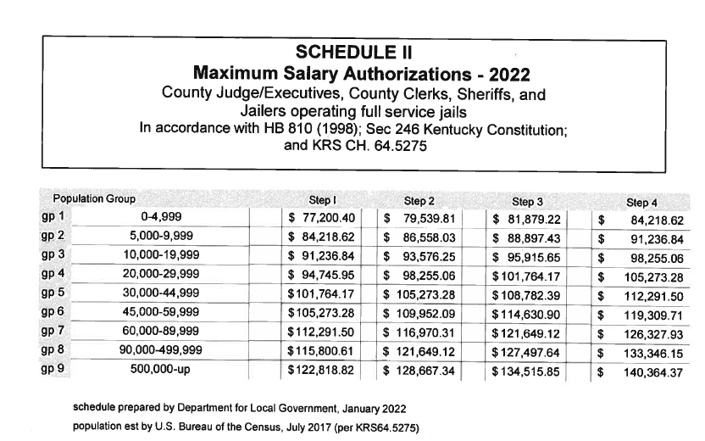
Notes:
This is the salary schedule that our office will be sending each County in the following months.
You can see that the table is broken down by population groups on the left and Steps that coincide with years of service on the top.
To find your salary you will find your County’s population on the left then for all newly elected officials with no previous years of service- you will be step one.
This table is only for CJEs, County Clerks, Sheriffs and Jailers operating full service jails.

Slide 70
Compensation/Monthly
KRS 64.535
The county judge/executive, clerk, sheriff and jailer who operates a full-service jail shall each receive a monthly salary of one-twelfth (1/12) of the amount indicated by the salary schedule.
Notes:
Read slide.
Give sheriff example of waiving pay until after taxes are collected.

Slide 71
Salaries of Elected Officials
Magistrates/Commissioners
By the first Monday in May in the year official is elected.
Jailer – Does not operate full-service jail
KRS 441.245
January 1999 - $20,000 minimum
Salary can be set at a higher level if salary does not exceed the constitutional salary limit applicable to jailers.
Shall be no less than the prior year's level
Notes:
JUST READ SLIDE

Slide 72
Salaries of Elected Officials
County Attorney
Prosecutorial duties
CPI
Coroner
Compensation set by fiscal court based upon population and depending upon level of training
KRS 64.185
Constable
Other County Officials – KRS 64.530
Notes:
County Attorney’s are also subject to CPI increases and there must be a line item allocation in the County’s budget to pay for the County Attorney’s services as legal advisor to the Fiscal Court.
Read rest of slide.

Slide 73
Salaries of Elected Officials
Fee Officials: Clerk & Sheriff
Non-Fee Pooling – Salary funded through fees.
Fee-Pooling – Salary funded through county budget.
Notes:
JUST READ SLIDE

Slide 74
Salaries of Elected Officials
Fee Officials: Clerk & Sheriff
Population over 70,000 – Paid through State Treasury. Salary paid according to Salary Schedule.
Population under 70,000 – Salary paid according to Salary Schedule
Notes:
JUST READ SLIDE

Slide 75
Funding For Salaries
Dependent upon:
1. Office
2. County’s Population
3. Budget
4. Other Factors
Majority of elected official’s salaries are paid through the county via the county treasurer.
Notes:
JUST READ SLIDE

Slide 76
Additional Compensation
House Bill 810 – Training Incentive
County Judge/Executive
Magistrates/Commissioners
County Clerk
Sheriff
Jailers
Notes:
In addition to your salary and expense allowances, there is also a voluntary training program formed under House Bill 810 that my colleague Wendy Thompson is going to go over with you at this time.

Slide 77
DLG Website William Summersett
Notes:
Thank you for having us here today.
I am Jaarad Taylor, one of the Local Government Advisors.
I serve the counties of the Bluegrass, Buffalo Trace, FIVCO and Gateway ADDs.
If you will be serving one of those counties, please make sure you stop me after this presentation and let me introduce myself.
Without further delay, I will be discussing Ordinances and the Handling of Public Funds.

Slide 78
DLG Website
kydlgweb.ky.gov
Office of Financial Management & Administration
Counties, Cities, Special Districts & Debt Reporting
Various Additional Pages throughout the Year
Local Issues Conference
Newly Elected Officials
Office of the Commissioner | Office of State Grants
County Officials Training Program | Office of Federal Grants
Kentucky Infrastructure Authority
Notes:
Our official web address is listed at the top of this slide and at the bottom of your “notes pages” we’ve provided in the folders.
This web address gives you direct access to a very informative portal that you can navigate for resources and hopefully become very familiar with.
This is just a quick snapshot of some areas on our website they you may find of interest.
Such as….. (READ MAIN BULLETS)

Slide 79
DLG Website
Notes:
By accessing our web address you’ll arrive at this screen. This is DLG’s Main Webpage.
On this page you will find the link to our Twitter account, which will keep you up to date on all the happenings.
All the financial information on our website is all considered public record and is drawn from the reports your counties submit.

Slide 80
Branch Resources Tile
Notes:
Still on our main webpage….on the right hand side you can access our Branch Resource Tiles.
All of these will be great resources for you.
Some of the tiles include the Commissioner’s Office, Local Officials Training Program, and the Staff Directory.

Slide 81
County’s Branch Information
Notes:
Let’s take a look at the County’s Branch Information tile because as County government you’ll be finding a wealth of information specifically here.

Slide 82
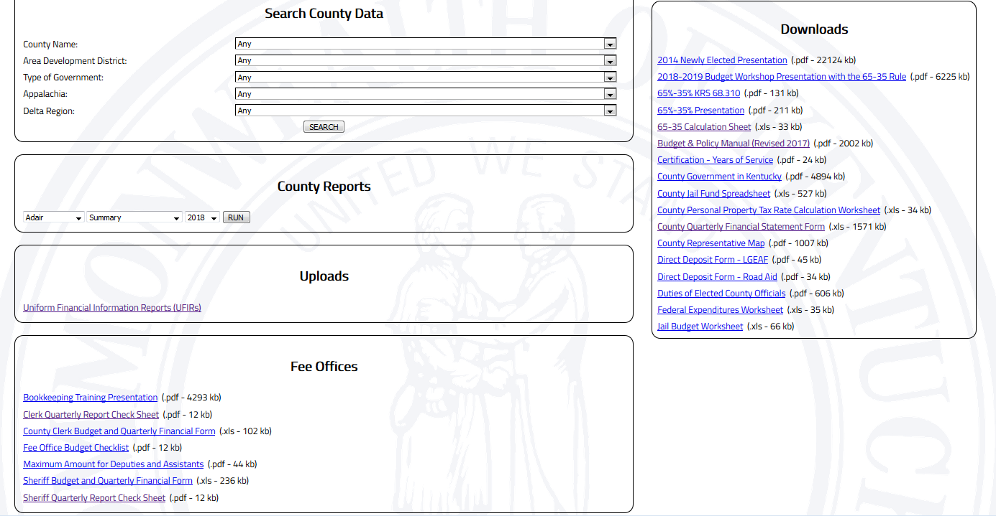
Public Information County Data
Notes:
Now we are on the County’s Page. The County’s report page will allow the public to review a variety of reports including all the county’s quarterly and annual financial data. This includes all expenditures.
The limitation of the report is that the data is only current through the most recent quarter.
To access your county’s quarterly and annual financial data, click the dropdown box under County Reports. Select Summary and the Year for which you’d like to review.
Then click RUN and the report is generated. You can also filter the Search County Data Box, by County, Area Development District, or the Type of Government.

Slide 83
Public Information County Data
Notes:
Now we are on the County’s Page. The County’s report page will allow the public to review a variety of reports including all the county’s quarterly and annual financial data. This includes all expenditures.
The limitation of the report is that the data is only current through the most recent quarter.
To access your county’s quarterly and annual financial data, click the dropdown box under County Reports. Select Summary and the Year for which you’d like to review.
Then click RUN and the report is generated. You can also filter the Search County Data Box, by County, Area Development District, or the Type of Government.

Slide 84
County Quarterly Financial Uploads
Signatures of the Judge/Executive &
Treasurer emailed or faxed separately
Notes:
Now we’ll take a look at the County Quarterly Financial Uploads Section.
This is where the treasurers will upload the Quarterly Financial Report.
The signature page for the Judge Executive and Treasurer can be emailed or faxed separately.

Slide 85
This Box Contains many of the Items that Counties will need.
Judge-Executives and Treasurers take note.
Notes:
The Downloads box is an excellent tool. Judge-Executives and Treasurers please take note.
You’ll find many forms you may need here, such as, the 65-35 Calculation Worksheet and the prior year certification that we need to calculate your salaries.
There are also two important manuals that may be helpful for you to download. The Duties of Elected Officials and County Government in Kentucky.

Slide 86
This Section Contains Information
For Fee Offices
Notes:
Now we’ll take a look at the fee offices section, for clerks and sheriffs.
In the fee offices box you can find the clerk and sheriff’s budget and quarterly report forms.
As well as the Maximum Amount for Deputies and Assistants.
You can also find a bookkeeping PowerPoint that we have used in past trainings that may be helpful.

Slide 87
The main page also provides access to other areas of interest
Notes:
Let’s take a look at the County’s Branch Information tile because as County government you’ll be finding a wealth of information specifically here.

Slide 88
Local Debt Reports and Reporting Can be found under this tile
Notes:
Let’s take a look at the County’s Branch Information tile because as County government you’ll be finding a wealth of information specifically here.

Slide 89
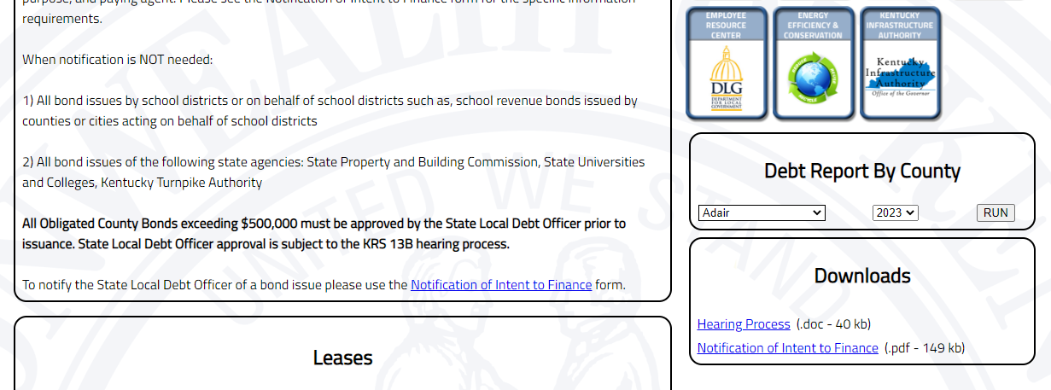
The Debt Report can be accessed in the drop-down boxes at the Right
The Notification of Intent to Finance is located in several places
Notes:
If you plan to finance a project with bonds or a lease, you can access the notification of intent to finance here.
We won’t cover the details of this process today, but know that we will help you with this when the time comes.

Slide 90
County Officials Training Incentive Program Wendy Thompson
Notes:
WENDY THOMPSON-Speaker

Slide 91
County Officials Training Incentive Program
Created by the 1998 Kentucky General Assembly with the passage of HB 810.
Challenged and upheld by the Kentucky Supreme Court.
Implemented in January 1999.

Slide 92
Things to Know About the Program
Commonly referred to by many officials as the HB 810 Training Program.
Authorizing Statute for the program is KRS: 64.5275 (6)
Administrative Regulations governing the program are:
109 KAR 2:020

Slide 93
KRS 64.5275 (6)
In addition to the step increases based on service in office, each officer shall be paid an annual incentive of one hundred dollars ($100) per calendar year for each forty (40) hour training unit successfully completed, based on continuing service in that office and, except as provided in this subsection, completion of at least forty (40) hours of approved training in each subsequent calendar year. If an officer fails, without good cause as determined by the commissioner of the Department for Local Government, to obtain the minimum amount of approved training in any year, the officer shall lose all training incentives previously accumulated. Each training unit shall be approved and certified by the Department for Local Government. No officer shall receive more than one (1) training unit per calendar year nor more than four (4) incentive payments per calendar year. Each officer shall be allowed to carry forward up to forty (40) hours of training credit into the following calendar year for the purpose of satisfying the minimum amount of training for that year. Each annual incentive payment shall be adjusted by the Department for Local Government on an annual basis for any increase or decrease in the consumer price index in the same manner as salaries are adjusted as described in subsection (4) of this section. The Department for Local Government shall promulgate administrative regulations in accordance with KRS Chapter 13A to establish guidelines for the approval and certification of training units.
Notes:
Can we condense this text? Eliminate part? Break it up over several slides?

Slide 94
Things to Know About The Program
Your participation is VOLUNTARY
Officials are not automatically enrolled as participants in the program. When DLG becomes aware of a new official we place them in the training database as a Non-Participant (NP). Until an official fills out a participation form for the program their status will remain as a Non-Participant. HOURS WILL NOT BE RECORDED UNTIL YOU OFFICIALLY TAKE OFFICE.
For officials that choose to participate and submit the proper documentation, DLG will enter/change the officials status to participating which is indicated by an (810) beside their name.
Once an official is out of office for whatever reason (resignation, retirement, or loss of election) their status will be changed to Ex-Official (EX). If the official is later re-elected this record is not reactivated but rather a new record is created.

Slide 95
Things to Know About the Program
Funding for the program is LOCAL, the money used to pay the training fringe benefit comes from County funds.
DLG’s role in the payment process is to notify the official of their completion and authorize the County to make the incentive payment.
There are specific line items in each County’s Budget for the officials Training Fringe Benefit. The accounting code for the training incentive will end in -212.

Slide 96
Participation in the Program
Who Can Participate:
Members of the Fiscal Court (Judge/Executives, Magistrates or Commissioners)
County Clerks
Sheriffs
Jailers

Slide 97
How to Participate
Notify your county’s Judge/Executive and/or Treasurer to ensure that funds are budgeted
Complete and submit the County Elected Officials Training Participation Form to DLG
Attend 40 hours of approved training each Calendar Year
Send documentation of your attendance to DLG within 60 days of training.

Slide 98
Incentive Payment Process For Fee Officials (County Clerk & Sheriffs)
County’s with a population of less than 70,000
The incentive can be paid from the fee account or by the fiscal court.
County’s with a population of 70,000 or greater
Notice will be mailed to the County Fees Office in the Finance and Administration Cabinet which will then send the payment to the official.

Slide 99
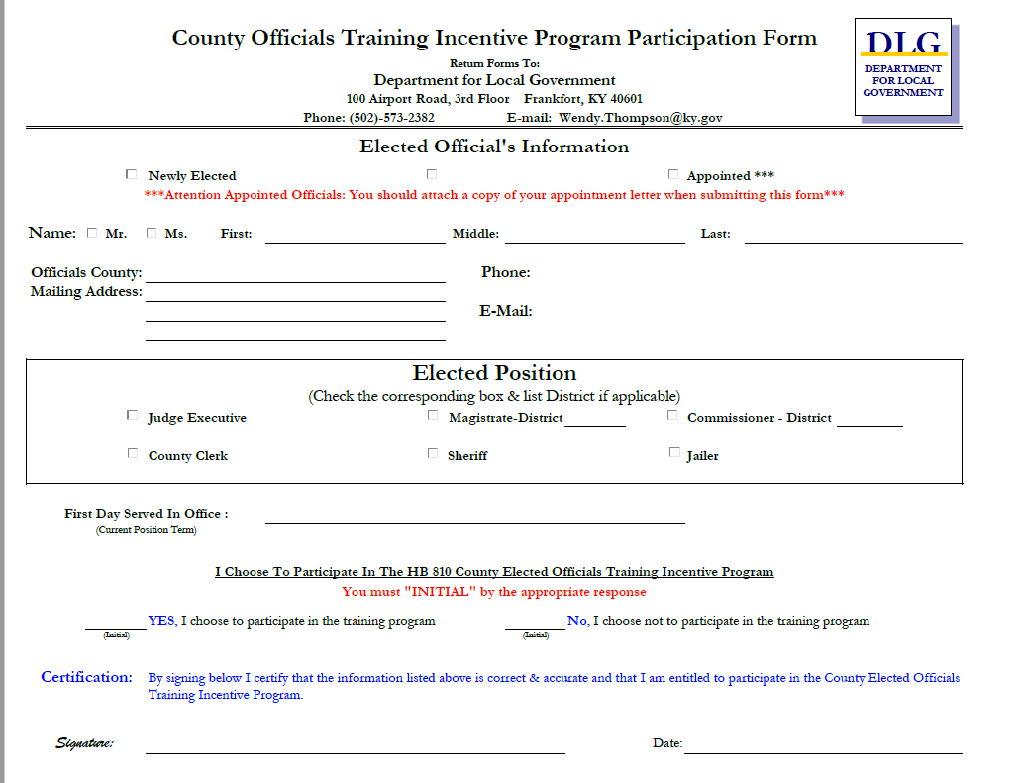
Participation Form

Slide 100
Policies Regarding Travel & Training Reimbursements
Each county determines its own policies regarding the reimbursement for travel and training expenses. While incentives earned are statutorily mandated county expenses, the cost of travel and tuition related to training are not mandated. Therefore, each county decides what they will fund. Please reference your administrative code for your County’s policy.

Slide 101
Approvable Training Topics
Legal/Legislative Issues
Budget Preparation
Election Training – County Clerk
Human Resources Training
Leadership training
Cybersecurity
Emergency Management
Transportation/Road – Fiscal Court
Corrections – Jailers
Constitutional & State Office Updates
Federal & State Grant Training
Hot Topic Items – Solar, Broadband, etc.
Officials should vary selections to include conferences as well as traditional classroom settings and live web-based training.
You need to select training that will benefit you in your role as an elected official!!!

Slide 102
Live Web-based Training
All approved training will be listed on your training page under relevant upcoming courses. ONLY web-based training listed on this page will be accepted.
On the listing for the training events, the event will be listed as (in-person) or (web-based) then the vendors name – title of the event. This will let you know right away which trainings are in-person and which are web-based. Example: YEAR (web-based) DLG – Training Guidelines or YEAR (in-person) DLG – Training Guidelines.
You must attend the entire course with the camera on. If they cannot see you, the training will not count.
Your trainer will certify your attendance and submit your attendance to DLG.

Slide 103
Potential Training Providers:
Professional Associations
Government Agencies
Area Development Districts
Independent Conferences and Training Groups

Slide 104
Reporting Your Attendance
Proof of an official’s training attendance should be submitted to the DLG office within 60 days of completing the training. (per 109 KAR 2:020 Section 3(8))
Always make sure your “Name”, “County” and “Office” are legible on your attendance form before submitting it.
Completed documentation can be submitted by the official or the training provider by mail or e-mail. NO PICTURES
Ultimately it is the responsibility of the official to make sure their attendance information has been turned in.

Slide 105
Proof of Attendance Documentation Generally Accepted by DLG
When attending a training event your proof of attendance should be submitted in the same document form as all the other officials.
Some of the acceptable forms are:
Sign-in Sheets
Attendance Logs/Reports
Individual Certificates
Individual Proof of Attendance Forms

Slide 106
Your Training Record
Reflects what you have certified that you attended on your Proof of Attendance Forms (POAs). So fill them out accurately!
If you need to leave the session to make a phone call, please make it very brief or mark on your POA for the amount of time you left the session.
Your record is Subject To Open Records Requests!!! As are all of your Proof of Attendance Forms.

Slide 107
How Much is the Incentive?
The amount of 1 incentive unit is $100 which adjust annually for changes in the Consumer Price Index (CPI).
2022 CPI: 7%
2022 Incentive Unit Values Are:
1st unit = $1,169.77
2nd unit = $2,339.54
3rd unit = $3,509.31
4th unit = $4,679.08

Slide 108
How Do I Earn an Incentive?
An incentive unit is comprised of the completion of 40 hours of approved training.
One incentive unit can be earned per calendar year by attending training and/or carrying forward hours from the previous year.
Carry forward hours are limited to a maximum of 40 hours that can be carried from one year into the next consecutive year of service.

Slide 109
How Do I Earn an Incentive?
The maximum amount of incentive units that an official can accumulate is capped at four units.
To maintain incentive units that have been consecutively accumulated, an incentive unit must be completed each calendar year.

Slide 110
When Will I Receive My Incentive Payment?
Once eligible, DLG will mail notice to the Official, the County Judge/Executive, the County Treasurer, and the State Auditors Office.
Payment is issued from County funds.
The Incentive Payment:
Must be budgeted.
Is subject to fiscal court review. No standing orders
Is subject to all State & Federal withholdings
Payment cannot be issued until the authorization letter has been received by your treasurer and has been approved by Fiscal Court.

Slide 111
When Are Letters Issued?
On average DLG issues incentive letters twice a month (around the 15th & 30th). However, there are times when the time period between incentives is greater than one month.
Letters are not issued during the months of May and June while we are working fiscal court budgets.

Slide 112
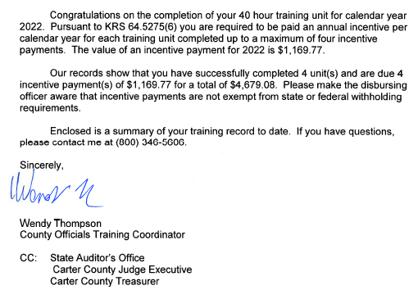
Letter of Confirmation for Incentive Achievement

Slide 113
Where Is My Letter?!?!
Have you given DLG some time to record the training? (usually entered within 2 weeks of receiving)
Is it May or June? DLG will not process incentive letters during these months so that we can focus all our time on processing county budgets.
Does DLG have your correct contact information?

Slide 114
How To Access Your Training Information
Go to the DLG website kydlgweb.ky.gov.
Look on the right hand side of the page and you will see a list of links that take you to the different sections of our agency.
Second row, 3rd button is the County Officials Training Program Link.

Slide 115
Accessing Your Training Information
Reports and Forms
Below are reports and forms that officials participating in the County Elected Officials Training Program will utilize. To view the corresponding report or forms click the heading of each section. County Elected Officials Training Program Participation Form (Adobe 125 KB) Elected or appointed officials who wish to participate in the County Elected Officials Training Program will need to complete and submit the County Elected Officials Training Program Participation Form before they will be included in the program. Newly elected or appointed officials who wish to participate in the County officials training program will need to complete this form and submit it to our office in order to be enrolled in the training incentive program. Individual Training Records By clicking the link above, program participants may view their individual training record online by entering their name, county, office or any combination thereof. Training Approval Request Form (Adobe 136 KB) For training events not listed in the Upcoming Approved Training Events, approval may be requested by completing and submitting the Training Approval Request Form, along with a detailed event agenda listing all training times and indicating any breaks and meals during the training event. To complete this form click the link in the heading listed above this section. For questions concerning the County Elected Officials Training Program
please contact Wendy Thompson, Training Coordinator.

Slide 116
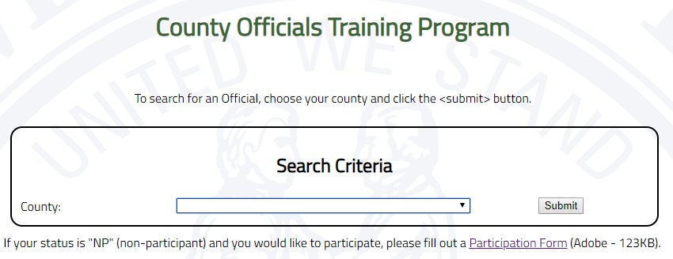
How To Access Your Training Information

Slide 117
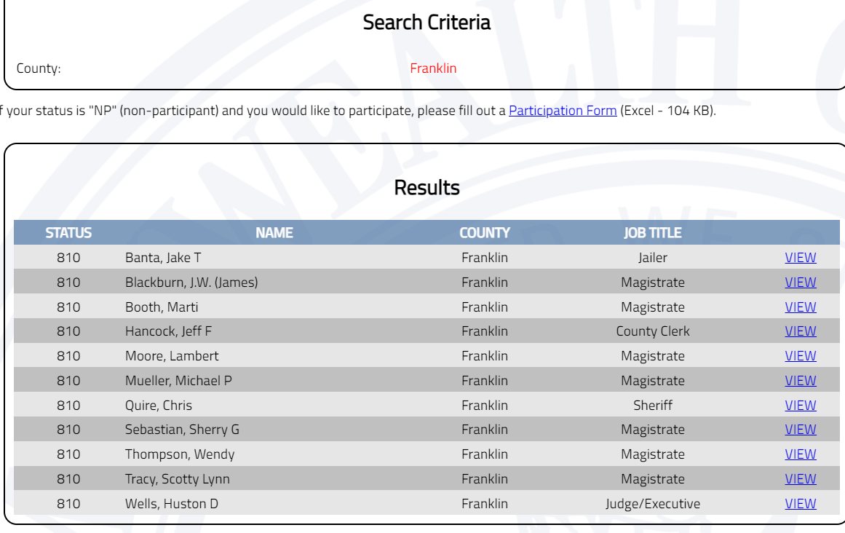
Accessing Your Training Information

Slide 118
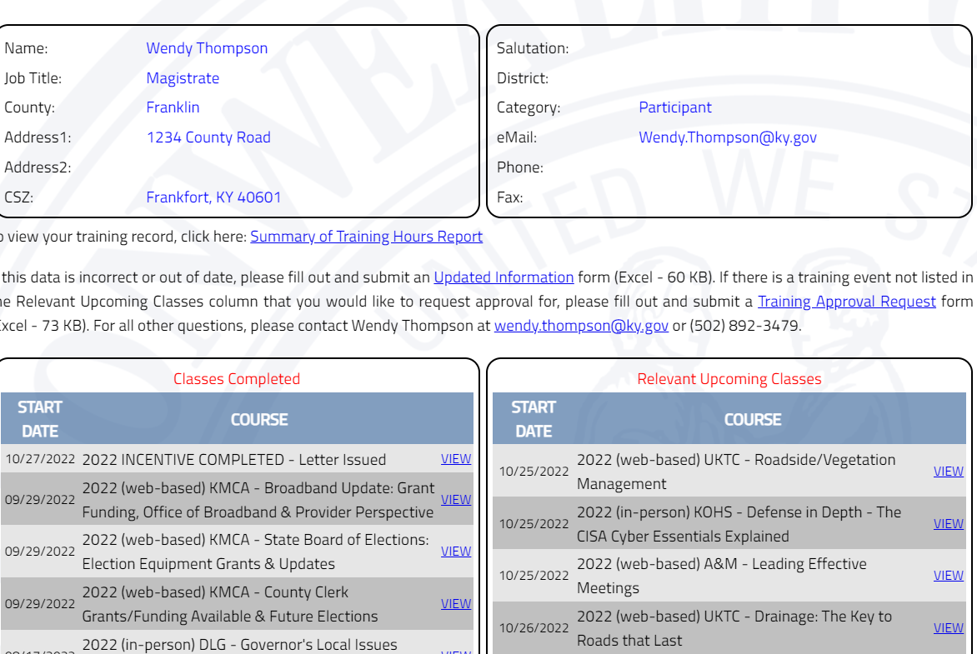
Accessing Your Training Information
Verify that your mailing & e-mail address is correct
Notes:
Check to make sure we have your correct mailing address. Be sure to point out the summary of Training Hours Report

Slide 119
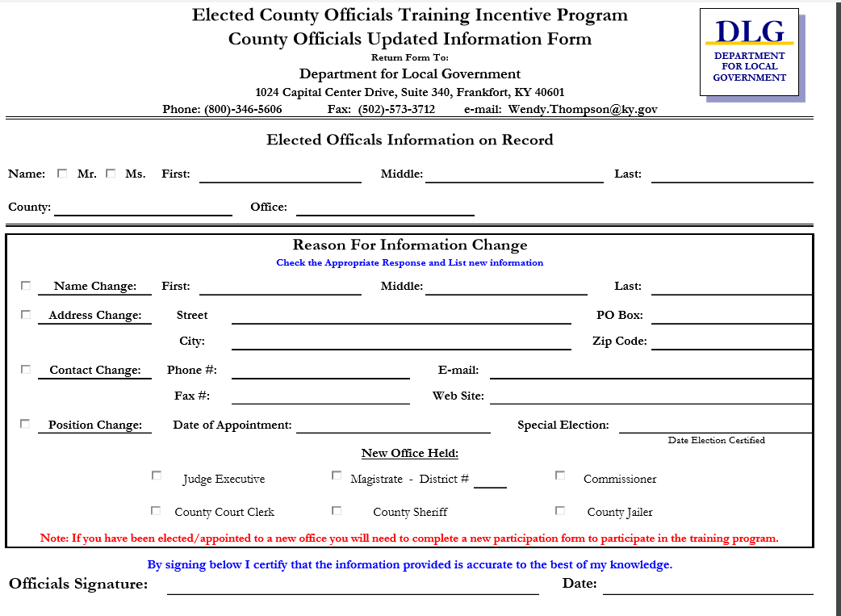
Correcting Your Contact Information

Slide 120
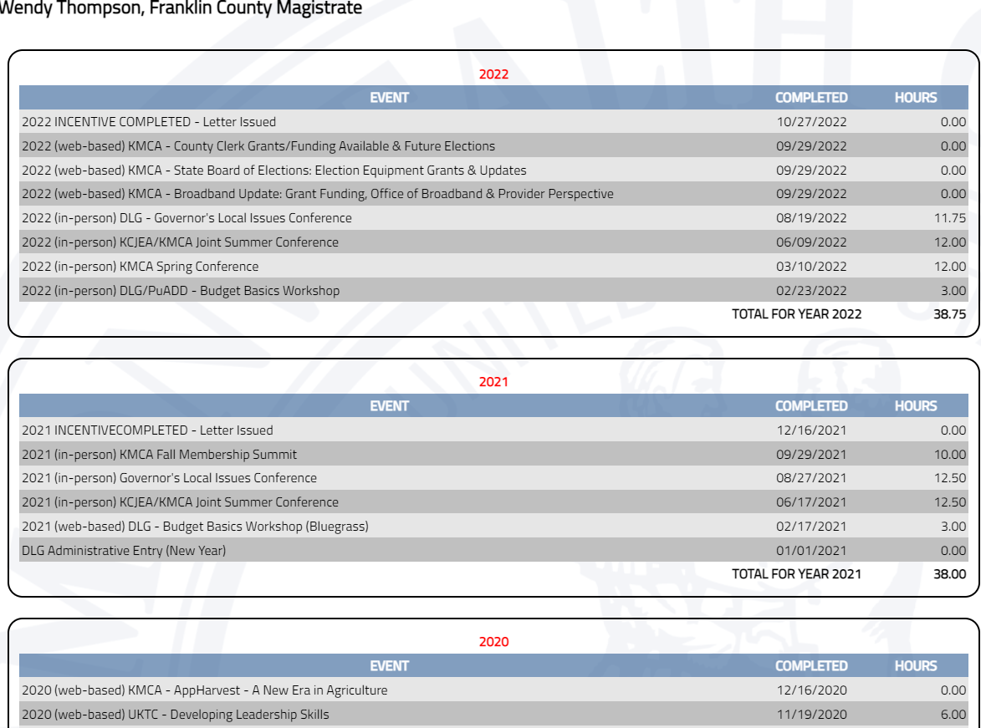
Training Record Transcript
Notes:
Hours listed as zero are on financial hold or have issues.

Slide 121
How to get a Training Event Approved
If a training event is not listed on your “Relevant Upcoming Classes List” it could be because DLG is not aware of the training. To get the training approved in this program we will need the “Training Approval Request Form” filled out and submitted to our office along with a “Detailed Agenda” for the training event. Please make sure the agenda lists times for each session.

Slide 122
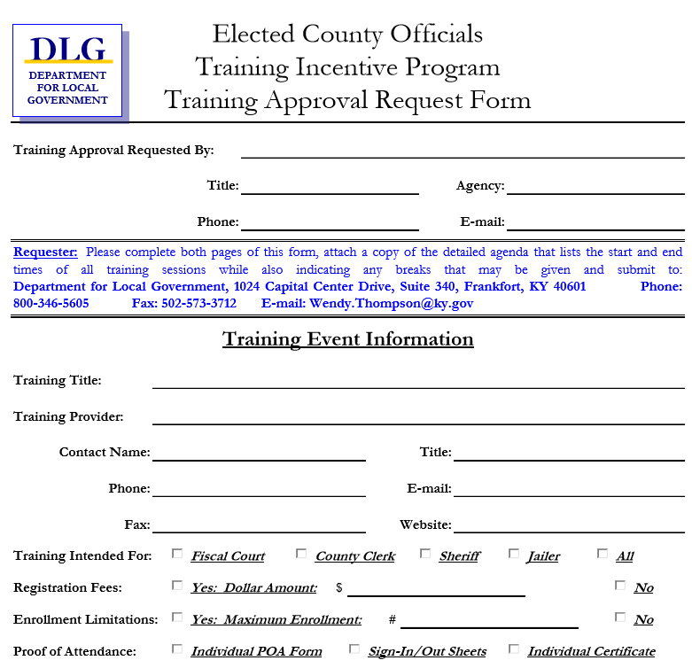
Training Approval Request Form
Notes:
This is a two page form. This is a snippet of what you are looking for.

Slide 123
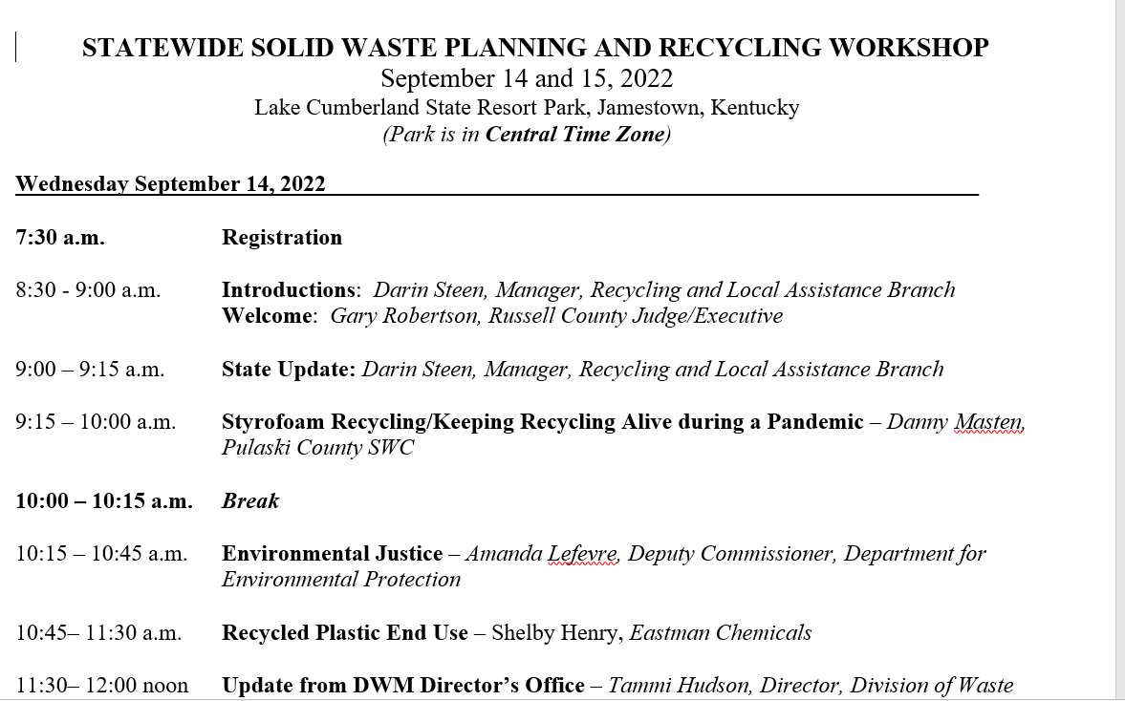
Provide us with a Detailed Agenda Sample

Slide 124
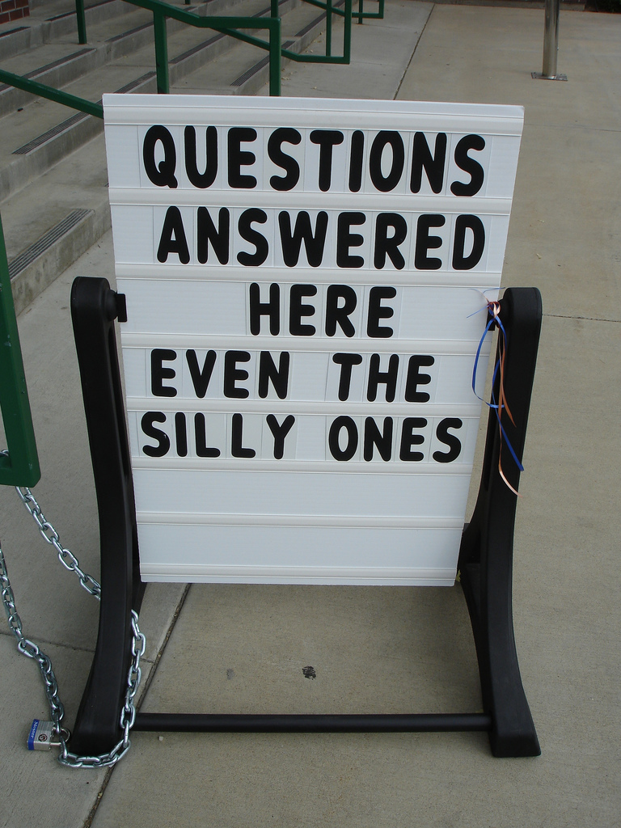
Commonly Asked Training Program Questions

Slide 125
I Have Completed My 40 Hours but Haven’t Received My Incentive Letter
Are you signed up to participate in the training program? To participate fill out the participation form that was covered earlier in this program.
Have you turned in all of your Proof of Attendance (POA) documentation? Your State Associations (KCJEA, KMCA, KCCA, KSA, KJA, & KACo) are very good about turning your attendance in for you. However, most training entities do not forward this information to DLG. If you have your POA you can scan and e-mail it to Wendy.Thompson@ky.gov.

Slide 126
I Have Completed My 40 Hours but Haven’t Received My Incentive Letter
Sometimes the association conducting the training has to document your attendance in their system before they forward that information on to DLG. It is not uncommon for DLG to receive attendance documentation two weeks after a training event has occurred.
Incentive letters are not automatically generated upon the completion of an incentive unit. Letters are issued usually around the 15th & 30th of each month.

Slide 127
The Training Event Didn’t Have A Certificate, Sign-in Sheet or a Proof of Attendance Form
This mostly happens with out-of-state training events. In the event that you attend a training event that does not provide the attendees with some type of proof of attendance (POA), simply:
Keep your agenda and “initial” by each session that you attended.
Write a letter on your office letterhead stating that you attended the training event listing its: name, date, and location and that you would like for the sessions initialed on your agenda to be considered for training credit.
Submit the initialed agenda and letter to DLG and we
will use it as your proof of attendance for the event.

Slide 128
I carried 40 hours into the New Year When will I get my Incentive Letter?
With the carry forward provision several officials that are continuing in the service of their office are eligible for their incentive as soon as the new year arrives. Before DLG can issue any incentives we have to:
Receive the CPI information from the US Department of Labor, Bureau of Labor Statistics (typically in the last part of January).
Use the CPI information to calculate the new years salary levels and incentive values.
Letters are typically received in early to mid February.

Slide 129
Other Training Questions
If you have any question about the County Elected Officials Training Program please contact Wendy Thompson at:
Phone: (toll free) 1-800-346-5606
Direct line at 502-892-3479
E-mail: Wendy.Thompson@ky.gov

Slide 130
Contact Us
Department for Local Government
Office of Financial Management & Administration
100 Airport Drive, 3rd Floor
Frankfort, KY 40601
502-573-2382
Fax: 502-227-8691

Slide 131
OFFICE OF STATE AND FEDERAL GRANTS
Department for Local Government
100 Airport Road
Frankfort KY, 40601

Slide 132
Office of State Grants
Coal Development Branch & Special Programs Branch
The Coal Development Branch administers the following:
Local Government Economic Development Fund (LGEDF) Single-County Coal Severance Grants
Local Government Economic Assistance Fund (LGEAF) Coal and Mineral Severance Program
The Special Programs Branch administers the following:
Regional Development Agency Assistance Program (RDAAP)
Flood Control Local Match Participation Program (LMPP)
House Bill 1 (Budget Bill) Line-Items (HB1)
Kentucky Mountain Regional Recreation Assistance (KMRRA)
Joint Funding Administration Program (JFA-ADD’s)
Notes:
Only Jefferson and Fayette Counties apply to the first two criteria. The Balance of 118 County Clerks are required to have $100,000 Dollar Bonds.

Slide 133
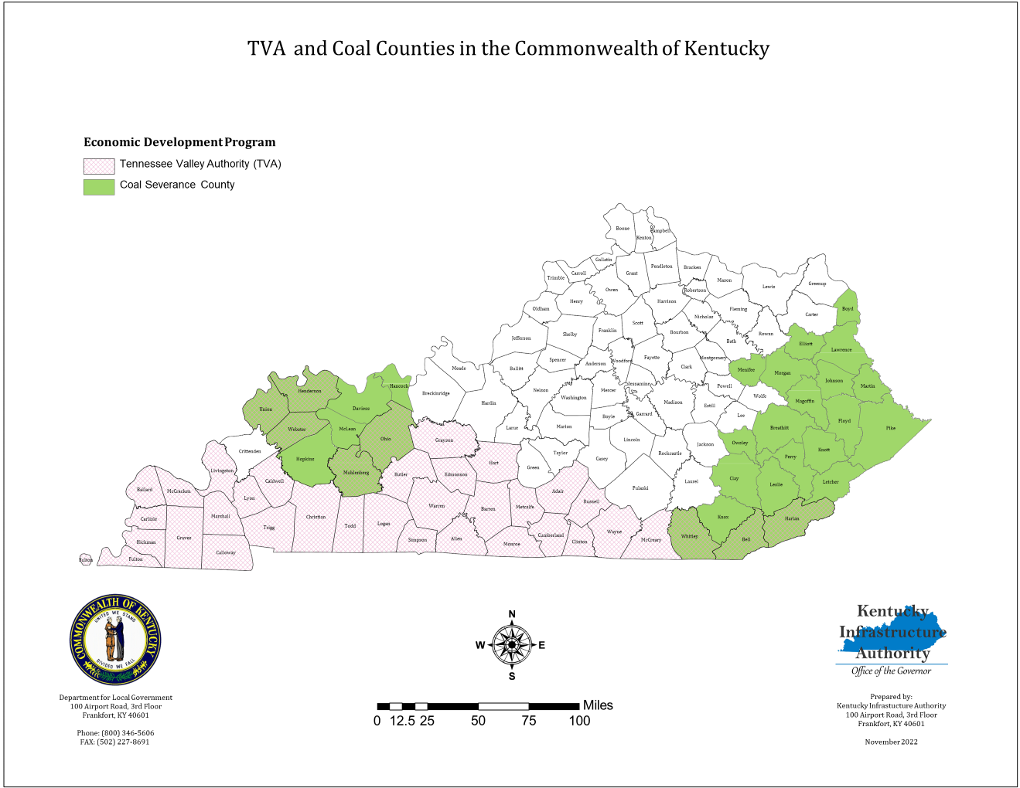
TVA & Coal Counties
Notes:
Only Jefferson and Fayette Counties apply to the first two criteria. The Balance of 118 County Clerks are required to have $100,000 Dollar Bonds.

Slide 134
Office of Federal Grants
Community Development Block Grants (CDBG)
Public Services
Recovery KY
Provide operational financing
Recovery Housing
Rehab & reconstruction, rent, lease, utilities
Public Facilities
Installation/rehab of water lines, water storage water/sewer upgrades, stormwater separation, lead pipe elimination
Economic Development
Creation/retention of jobs
Community Projects
Senior/community centers, public libraries, volunteer fire departments, health departments
Housing
Rehab of homes, relocation of households, acquisition of dilapidated structures

Slide 135
Recreational Trails Program
Office of Federal Grants
Land & Water Conservation Fund
Administered by the Department of Transportation, Federal Highway Administration.
Purpose: provide funding for the development and maintenance of recreational trails, and trailside and trailhead amenities for both non-motorized and motorized trails.
Grants are provided to cities and counties on a matching basis for up to eighty percent (80%) of the total project costs.
The maximum grant amount is $250,000.
Administered by the U.S. Department of the Interior, National Park Service.
Purpose: provide funding for the acquisition and development of public outdoor recreation sites and facilities.
Grants are provided to cities and counties on a matching basis for up to fifty percent (50%) of the total project costs.
The maximum grant amount is $250,000.
Notes:
Eligible projects for Land & Water: Basketball/Tennis/Pickleball courts, Football/Soccer/Ball fields, Picnic areas, Pool/Splash pads, Campground, Trails, Playgrounds, Amphitheaters, Passive Parks, Docks/Fishing piers, Restrooms, parking, lighting
Eligible projects for Rec Trails: maintenance and restoration of existing recreational trails, development and rehab of trailside and trailhead facilities, purchase and lease of rec trail construction and maintenance equipment, acquisition of easements and property for recreational trails.

Slide 136
Office of Federal Grants
Appalachian Regional Commission (ARC)
ARC is a federal-state economic development program designed to assist in the economic development of Appalachia through a diversity of projects in the areas of public infrastructure (water, sewer, solid waste, housing, and telecommunications), human resource development (education/workforce development, affordable/accessible healthcare, and leadership development) and business/entrepreneurial development.
ARC is led by a Commission composed of the Governors from each of the Region’s 13 states, and a Federal Co-Chair who is appointed by the President and confirmed by the Senate. (ARC States: Alabama, Georgia, Kentucky, Maryland, Mississippi, New York, North Carolina, Ohio, Pennsylvania, South Carolina, Tennessee, Virginia, and West Virginia)
Kentucky’s ARC Region is comprised of 54 Counties in Eastern and South Central Kentucky that are located in 9 Area Development Districts (ARC ADD’s: All Counties-Big Sandy, Buffalo Trace, Cumberland Valley, Gateway, FIVCO, KY River, and Lake Cumberland; Some Counties- Bluegrass, and Barren River
Notes:
Examples of eligible projects: water/sewer line extension and treatment expansion; telecommunication/broadband deployment; learning center development; education/workforce development training; industrial site development; asset-based development planning/activities; and, leadership development/civic capacity building.

Slide 137
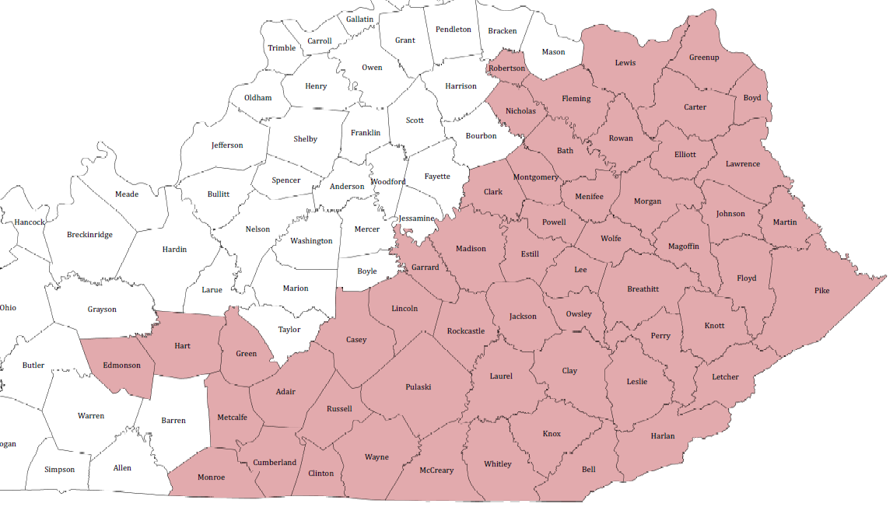
Office of Federal Grants
Appalachian Regional Commission (ARC)

Slide 138
Office of Federal Grants
Delta Regional Authority (DRA)
Established in 2000 by Congress, the Delta Regional Authority makes strategic investments of federal appropriations into the physical and human infrastructure of Delta communities.
DRA Board is comprised of the Federal Co-Chairman, appointed by the President and confirmed by the U.S. Senate, and the governors of the eight states (Alabama, Arkansas, Illinois, Kentucky, Louisianan, Mississippi, Missouri, and Tennessee)
DRA Region in KY consists of all the Counties in the Purchase and Pennyrile ADD’s, and 4 Counties in the Green River ADD (Henderson, McLean, Union and Webster).
Notes:
Eligible projects: basic public infrastructure, transportation infrastructure, business development (focus on entrepreneurship) and workforce development

Slide 139
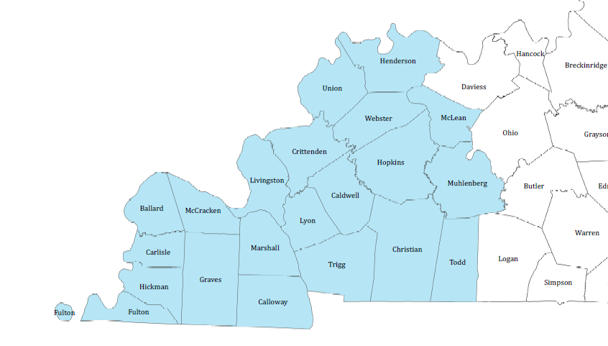
Office of Federal Grants
DRA Region in KY
Notes:
Eligible projects: basic public infrastructure, transportation infrastructure, business development (focus on entrepreneurship) and workforce development

Slide 140
Website: kydlgweb.ky.gov
502-573-2382
Department for Local Government
100 Airport Road 3rd Floor
Frankfort KY, 40601

